Slide 1
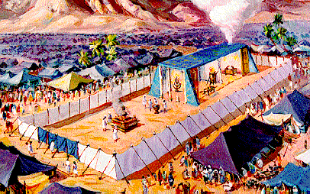
The Tabernacle המשכן
Notes:
http://www.domini.org/tabern/tabhome.htm

Slide 2
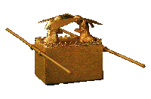
Why Study the Tabernacle?
Now these things happened to them as an example, and they were written for our instruction, upon whom the ends of the ages have come.
1 Corinthians 10:11

Slide 3
Why Study the Tabernacle?
All Scripture is inspired by God and profitable for teaching, for reproof, for correction, for training in righteousness; so that the man of God may be adequate, equipped for every good work.
2 Timothy 3:16-17

Slide 4
Why Study the Tabernacle?
Now if He were on earth, He would not be a priest at all, since there are those who offer the gifts according to the Law; who serve a copy and shadow of the heavenly things, just as Moses was warned by God when he was about to erect the tabernacle; for, "SEE," He says, "THAT YOU MAKE all things ACCORDING TO THE PATTERN WHICH WAS SHOWN YOU ON THE MOUNTAIN."
Hebrews 8:4-5

Slide 5
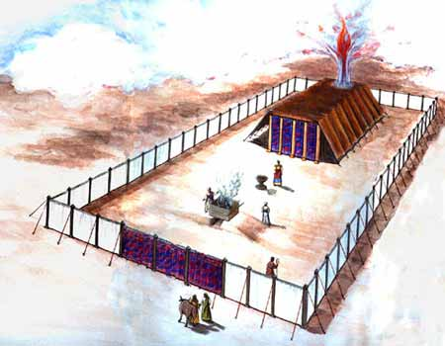

Slide 6
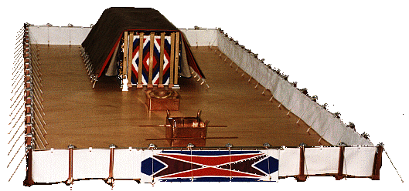

Slide 7
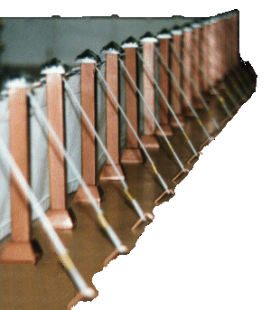
The Curtain

Slide 8
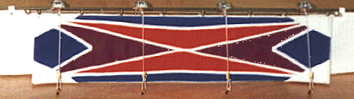
The Entrance

Slide 9
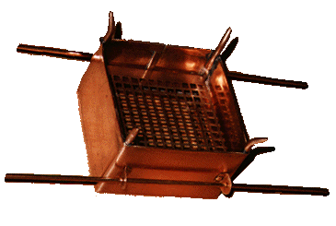
The Brazen Altar

Slide 10
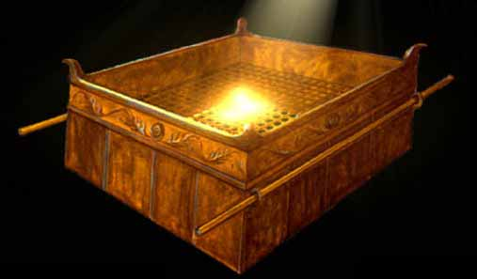
Brazen Altar

Slide 11
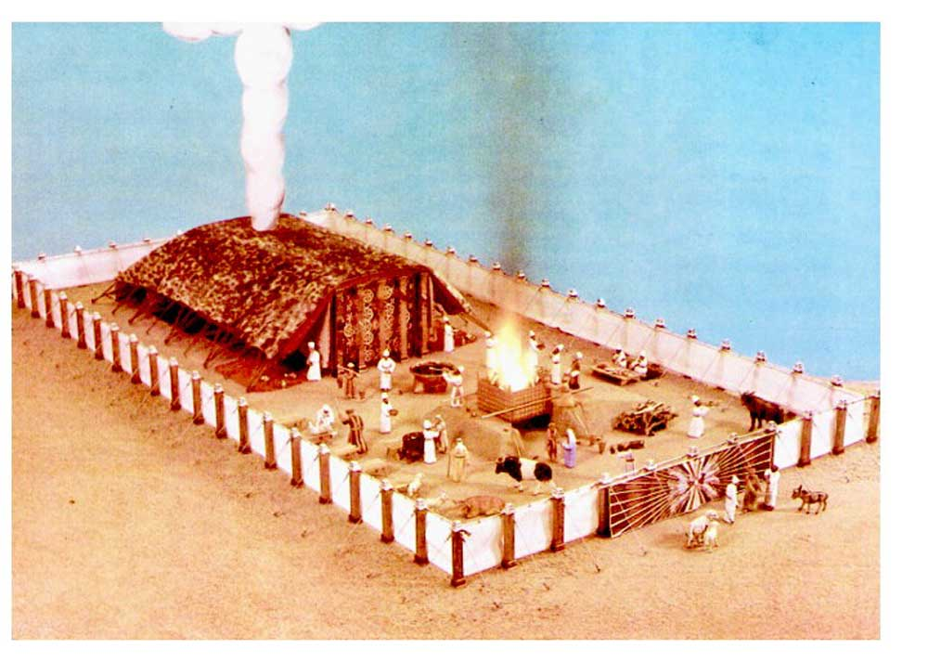
The Courtyard

Slide 12
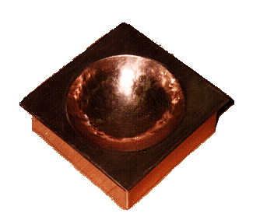
Brazen Laver

Slide 13
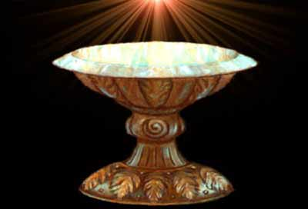
Brazen Laver

Slide 14
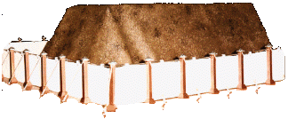
Badger Skin

Slide 15
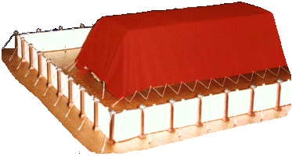
Ram Skin

Slide 16
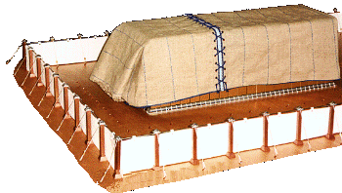
Goat Skin

Slide 17
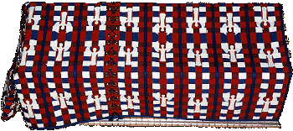
Cherub Covering

Slide 18
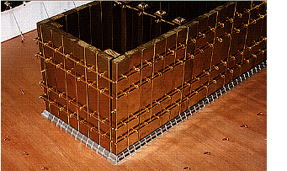
Boards

Slide 19
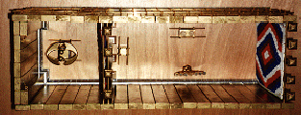
Layout

Slide 20
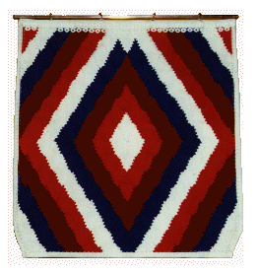
Entrance

Slide 21
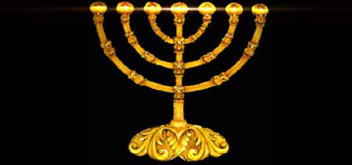
Lampstand
Ephesians 1:17 that the God of our Lord Jesus Christ, the Father of glory, may give to you a spirit of wisdom and of revelation in the knowledge of Him. 18 I pray that the eyes of your heart may be enlightened, so that you will know what is the hope of His calling, what are the riches of the glory of His inheritance in the saints, 19 and what is the surpassing greatness of His power toward us who believe. These are in accordance with the working of the strength of His might

Slide 22
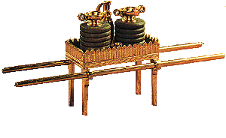
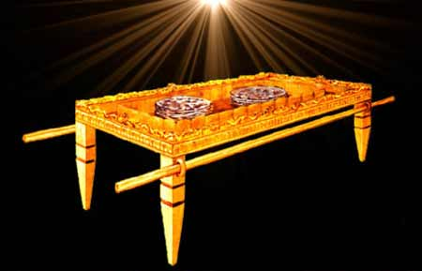
Table of Showbread

Slide 23
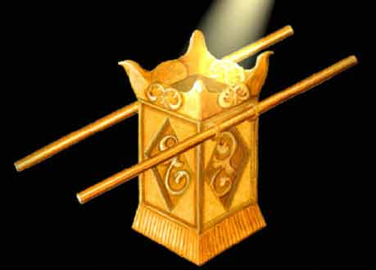
Altar of Incense

Slide 24
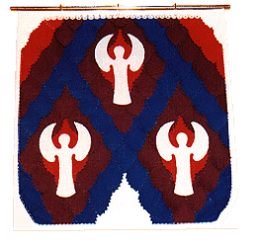
Veil

Slide 25
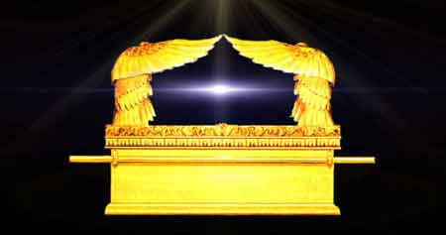
Ark of the Covenant

Slide 26
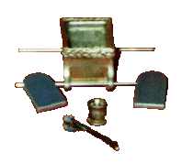
Ark of the Covenant
Contents

